Slide 1
Prediction of User Appreciation of Yelp’s Businesses Based on Text Reviews Hidden Features
CS 521 -Statistical Natural Language Processing

Slide 2
Outline
Introduction
Data Analyses
Approach
Experiment Results
Conclusion

Slide 3
Outline
Introduction
Data Analyses
Approach
Experiment Results
Conclusion

Slide 4

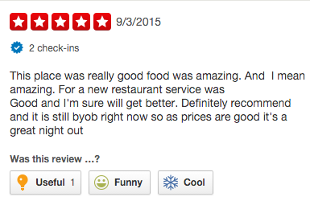
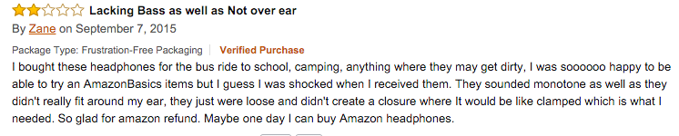
Introduction(1/3)
subscribe

Slide 5
Introduction(2/3)
A key tool for the Social Network Services is a good Recommendation System
But… what is a Recommendation System?
?

Slide 6
Introduction(3/3)
Most of the websites are based on user-generated content
It means we have a lot of text information to exploit
The goal is to extract tastes of the users in order to enhance the performance of recommendation systems
LDA
[t₁,t₂,…,t_{n}]_{i}
Hidden-features
score
Personal tastes of an user which can be even unconscious for the user himself
[s₁,s₂,…,s_{n}]₁
[s₁,s₂,…,s_{n}]₂
Recommendation
System
[s₁,s₂,…,s_{n}]_{i}
...
Predict what the user likes and what not
[s₁,s₂,…,s_{n}]_{m}

Slide 7
Outline
Introduction
Data Analyses
Approach
Experiment Results
Conclusion

Slide 8
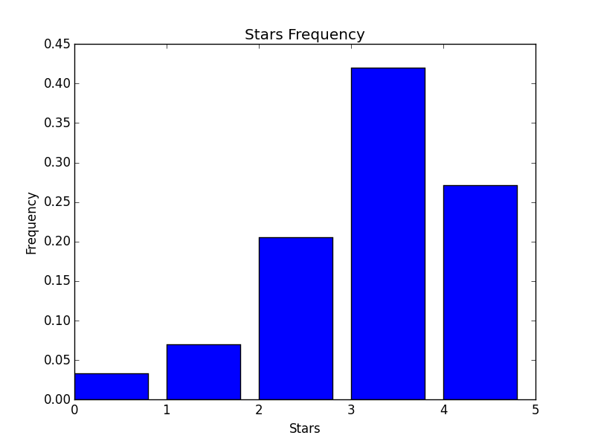
Data Analyses(1/1)
We have used the Yelp Dataset Challenge[1] that is public available
1.6M reviews
500 Tips
366K Users
61K Business
Several cities across the world
(Edinburgh, Karlsruhe, Montreal, Waterloo, Pittsburgh, Charlotte, Urbana-Champaign, Phoenix, Las Vegas, Madison)
about
Edinburgh:
23780 reviews
3150 users
4576 businesses
However...
In this way we can only access to reviews of businesses in Edinburgh
[1]:http://www.yelp.com/dataset_challenge

Slide 9
Outline
Introduction
Data Analyses
Approach
Data Preprocessing
Algorithms
Experiment Results
Conclusion

Slide 10
Approach(1/2)
Data Preprocessing – Hidden Features
I had a pretty good experience at the Doric. Yes, the restaurant is upstairs and you have to do a little exploring to find the staircase. The food was decently priced and the beer was pretty good. Service was fast and helpful.
POS(Penn Treebank)
What is important?
I/PRP had/VBD a/DT pretty/RB good/JJ experience/NN at/IN the/DT Doric/NNP.
Yes/UH, the/DT restaurant/NN is/VBZ upstairs/JJ and/CC you/PRP have/VBP to/TO do/VB a/DT little/JJ exploring/NN to/TO find/VB the/DT staircase/NN.
The/DT food/NN was/VBD decently/RB priced/VBN and/CC the/DT beer/NN was/VBD pretty/RB good/JJ.
Service/NNP was/VBD fast/RB and/CC helpful/JJ.

Slide 11
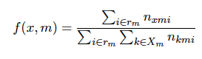
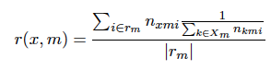
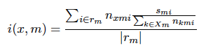
Approach(2/2)
Data Preprocessing – Hidden Features
Some parameters definition:
r_{m} set of reviews of user m
X_{m} set of relevant words of the user m
n_{xmz} the numer of times the word x appear in the review z
s_{mz} the rank that user m gives to review z
For each extracted words we have defined the following features:
Frequency:
Regularity:
Relevance:

Slide 12
Outline
Introduction
Data Analyses
Approach
Data Preprocessing
Algorithms
Experiment Results
Conclusion

Slide 13
Approach(1/2)
Algorithms - Method 1°
User
Features
Business
Features
Top-n
Frequency
Top-n
Regularity
Ensemble Method:
SVM linear
SVM RBF
Naïve Bayes
Logistic Regression(MaxEnt)
Top-n
Relevance

Slide 14
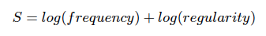
Approach(2/2)
Algorithms – Method 2°
1-2 stars
Top-n words
Based on Score Function
1-2 stars
Classifier
3 stars
Top-n words
Based on Score Function
3 stars
Classifier
Adaptive Boosting
4-5 stars
Top-n words
Based on Score Function
4-5 stars
Classifier

Slide 15
Outline
Introduction
Data Analyses
Approach
Experiment Results
Conclusion

Slide 16
Experiment Results(1/3)
80% Test Set
10% Validation Set
10% Test Set
Baseline:
Majority Class – We have 9 classes, accuracy ≈11%
Majority Class – Actually only 5 classes appear, accuracy ≈20%
Majority Class per user – For each user we predict its majority class ≈ 44.9%

Slide 17
Experiment Results(2/3)
A big issue in Recommendation System is: cold start problem
Since, we do not want to deal with it, we decide to consider user with at least a minimum number of reviews.
Min Reviews | 20 | 25 | 50 | 75
Baseline | 0.441 | 0.442 | 0.449 | 0.449
Method1 | 0.445 | 0.446 | 0.455 | 0.445
Method2 | // | // | 0.539* | //
Second Method Accuracy per class:
Class | [1-2] | [3] | [4-5]
Baseline | 0.917 | 0.768 | 0.463
Method2 | 0.917 | 0.795* | 0.587*
*p-value ≈ 0

Slide 18
Experiment Results(3/3)
Error Analysis
True \Predicted | 1 | 2 | 3 | 4 | 5
1 | 0 | 5 | 8 | 5 | 4
2 | 1 | 17 | 20 | 43 | 11
3 | 0 | 17 | 144 | 113 | 27
4 | 0 | 22 | 67 | 422 | 66
5 | 0 | 14 | 18 | 153 | 140
Method | Average Error
Baseline | -0.15
Method1 | -0.10
Method2 | -0.08

Slide 19
Outline
Introduction
Data Analyses
Approach
Experiment Results
Conclusion

Slide 20
Conclusion
It is possible to extract user related information only from text
Flexible Approach
Computational Attractive (100 ≈ 4 minutes)
Future Works:
Add sentiment analysis
Extend the considered words with synonyms and/or hyperym
Integrate the proposed method with existing recommendation techniques
Try the method on other social media and on stratified datasets

Slide 21

Questions?

Slide 22

Thank you!

Slide 23
Detailed Analysis - Input
Details!
Restaurant{0.012, 0.033, 0.11}
Beer {0.023, 0.001,0.12}
…
Bar{0.017, 0.023,0.09}
[u₁,u₂,u₃, … , u_{k}]
Restaurant{0.003, 0.031, 0.01}
Beer {0.012, 0.01,0.09}
…
Bar{0, 0,0}
Restaurant{0.003, 0.031, 0.01}
Beer {0.012, 0.01,0.09}
…
Service{0.043, 0.053,0.09}
[b₁,b₂,b₃, … , b_{h}]
[u₁,u₂,u₃, … , u_{k}] [b₁,b₂,b₃, … ,b_{k}]
Model1:
30≤k≤60 -> 90≤#features≤180
Model2:
0≤ k ≤100 -> 0≤#features≤200
Input
Top n:
Model1 -> n = 30
Model2 -> n = 100
MODEL

